Slide 1

Oh my lock!
Christophe Laporte
He / Him
Consultant
Conseil IT

Slide 2



Christophe
LAPORTE
He/Him
Consultant
I started working with SQL Server in 1997 and now focusing on high availability, VLDBs and virtualization, I also deliver performance audits and help companies in choosing the appropriate architectures (Cloud, OnPremise or Hybrid).
In addition to the MCM certification, I’m also a SQL MVP (2009), speaker and Microsoft Certified Trainer (2000).
Conseil IT
@conseilit
conseilit@outlook.com
conseilit.wordpress.com

Slide 3
What is a lock ?
Let’s generate a lock
Default properties for the demo database
Session 1 : Update some data
Session 2 : Select those data
And … Session 2 is blocked !
Session 2 can’t go on and read data

Slide 4
What is a lock ?
Occurs when a session takes the « ownership » of a resource
Mechanism
To avoid consistency issues
To enforce ACID properties of a transaction

Slide 5
Let’s talk about ACID
Atomicity
The transaction is considered as a unit of work
Consistency
The database must be in a consistent state after the transaction
Isolation
Changes remains even if a system failure occurs
Durability
Multiple transactions perform independently
It takes place at once or doesn’t happen at all
It should be before !
No interference between transactions
Changes persisted in the transaction log

Slide 6
Isolation levels vs integrity
 |  | Phenomena
 |  | Dirty reads | Non-Repeatable reads | Phantom reads
Isolation Level | Read Uncommitted | Yes | Yes | Yes
 | Read Committed | No | Yes | Yes
 | Repeatable Read | No | No | Yes
 | Serializable | No | No | No
 |  | Happens when a transaction is allowed to read the uncommitted changes of some other concurrent transaction | Happens when a transaction reads the same row(s) twice with different values. Another transaction (update) interfere | Happens when a transaction reads data, with the same filter criteria, twice yields different result set. Another transaction (insert/delete) interfere

Slide 7
Hence the locks !
To ensure ACID properties of a transaction
Type and lifetime governed by
The session isolation level
Explicit transactions
The query itself (Hints)
But as a DBA/Developer you must
Understand locks
And learn how to detect them (solve them ?)

Slide 8
Lock modes and resources
Database
Shared Lock (S)
Table
Intent Shared Lock (IS)
Page
Row/Key
Intent Shared Lock (IS)
Shared Lock (S)
Database
Shared Lock (S)
Table
Intent Exclusive (IX) / Intent Update (IU) Lock
Page
Row/Key
Intent Exclusive (IX) / Intent Update (IU) Lock
Exclusive(X) / Update (U) Lock
Session #2
Session #1
https://learn.microsoft.com/en-us/sql/relational-databases/sql-server-transaction-locking-and-row-versioning-guide

Slide 9
Lock modes and resources
Database
Shared Lock (S)
Table
Intent Shared Lock (IS)
Page
Row/Key
Intent Shared Lock (IS)
Shared Lock (S)
Locking scenario
Database
Shared Lock (S)
Table
Intent Exclusive (IX) / Intent Update (IU) Lock
Page
Row/Key
Intent Exclusive (IX) / Intent Update (IU) Lock
Exclusive(X) / Update (U) Lock
Session #2
Session #1

Slide 10
Getting information about locking scenario
T-SQL queries based on DMVs/ DMFs
sys.dm_exec_requests
sys.dm_tran_locks
All-in-one stored procedure
Adam Machanic sp_whoisactive
Investigations through indexes
Index operational stats

Slide 11
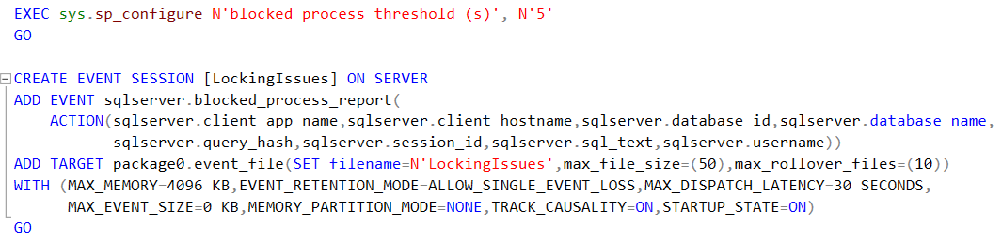
Blocked Process Report
Configuration
SSMS / T-SQL / PowerShell
Threshold to configure
Event viewing
SQL Server Profiler ( !?! )
xEvent session

Slide 12
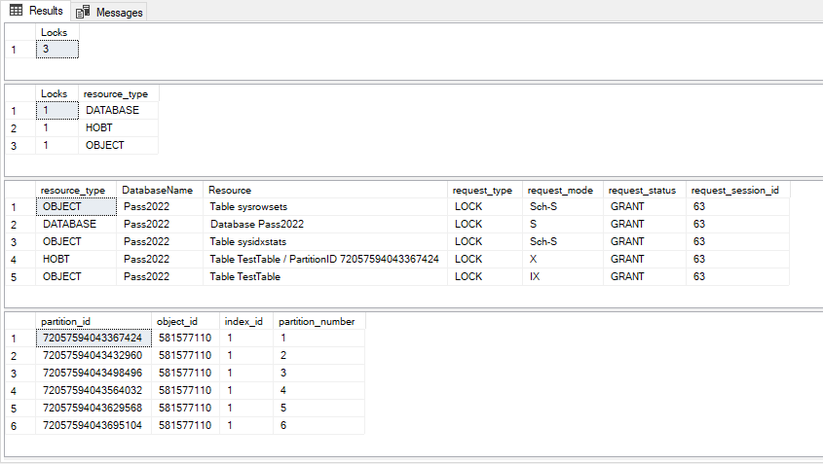
Bonus - Lock escalation
Lock escalation
Might occurs when 5000+ rows involved
Sys.dm_db_index_operational_stats
index_lock_promotion_attempt_count
index_lock_promotion_count
Partitioned tables
Intermediate level : HOBT
Investigations through indexes (again)
Index operational stats

Slide 13
Key Takeaway
Locking is a natural behavior
To ensure ACID properties of transactions
Not a problem except when results in
Blocking
Deadlocking
How to improve concurrency ?
RCSI / Row versioning is an option
Keep your transaction as short as possible
Take care about multi-column indexes
Primary Key implemented as Clustered Index ?

Slide 15
Thanks for your attention Feel free to ask any questions
Christophe Laporte
@conseilit
conseilit@outlook.com
in/christophelaporte

